Slide 1
CRAG Workshop Opening Remarks
Xiao Yang, Meta Reality Lab
Scott Yih, Meta Fundamental AI Research (FAIR)
Aug 27 2024

Slide 2
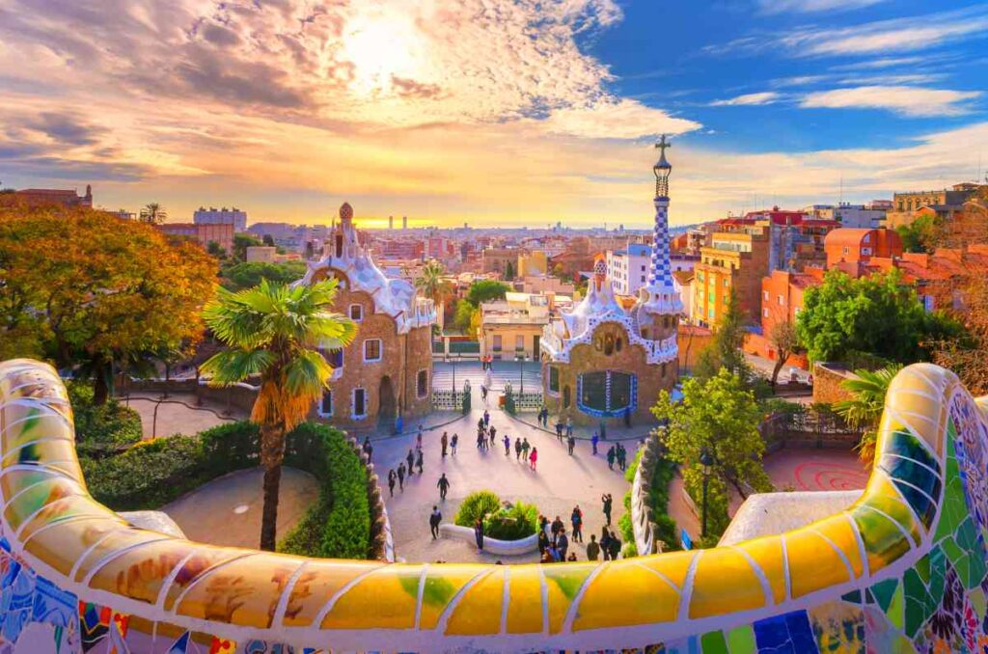
Welcome!
Notes:
Welcome to Barcelona!
Welcome to the KDD CRAG Workshop!
Thanks all the teams who accompanied us for the journey!

Slide 3
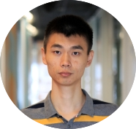
Acknowledgement
Workshop organizers
CRAG co-authors
Hao Xin, Yushi Sun, Nikita Bhalla, Xiangsen Chen, Sajal Choudhary, Rongze Daniel Gui, Ziran Will Jiang, Ziyu Jiang, Lingkun Kong, Brian Moran, An Yan, Chenyu Yang, Eting Yuan, Hanwen Zha, Nan Tang, Lei Chen, Nicolas Scheffer, Yue Liu, Nirav Shah, Rakesh Wanga, Anuj Kumar
Xiao Yang
Kai Sun
Ethan Xu
Jiaqi Wang
Scott Yih
Luna Dong

Slide 4
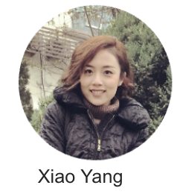
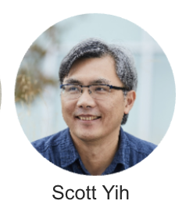
Agenda
KDD Cup CRAG Challenge Summary
Effective RAG Techniques

Slide 5
2024 KDD Cup CRAG Challenge Summary
2300+ participants, 384 teams, 5600+ submissions
Winning teams’ solutions significantly outperformed the baseline solutions!
CRAG benchmark (arXiv link) was listed in Hugging Face "Daily papers"!
Lots of media attention
Link: https://www.aicrowd.com/challenges/meta-comprehensive-rag-benchmark-kdd-cup-2024
Notes:
Welcome to Barcelona!
Welcome to the KDD CRAG Workshop!
Thanks all the teams who accompanied us for the journey!

Slide 7
CRAG Benchmark Overview
CRAG Tasks
Question Answering Pairs
Retrieval
Web Search Results
Evaluation
Mock KG & APIs

Slide 8
CRAG Benchmark Overview
Question Answering Pairs
Rich and insightful question-answering set
Retrieval
Web Search Results
Accessible retrieval contents.
Mock KG & APIs

Slide 9
CRAG Benchmark Overview
CRAG Tasks
Question Answering Pairs
Carefully-designed
Retrieval
Web Search Results
Evaluation
Reliable
Mock KG & APIs

Slide 10
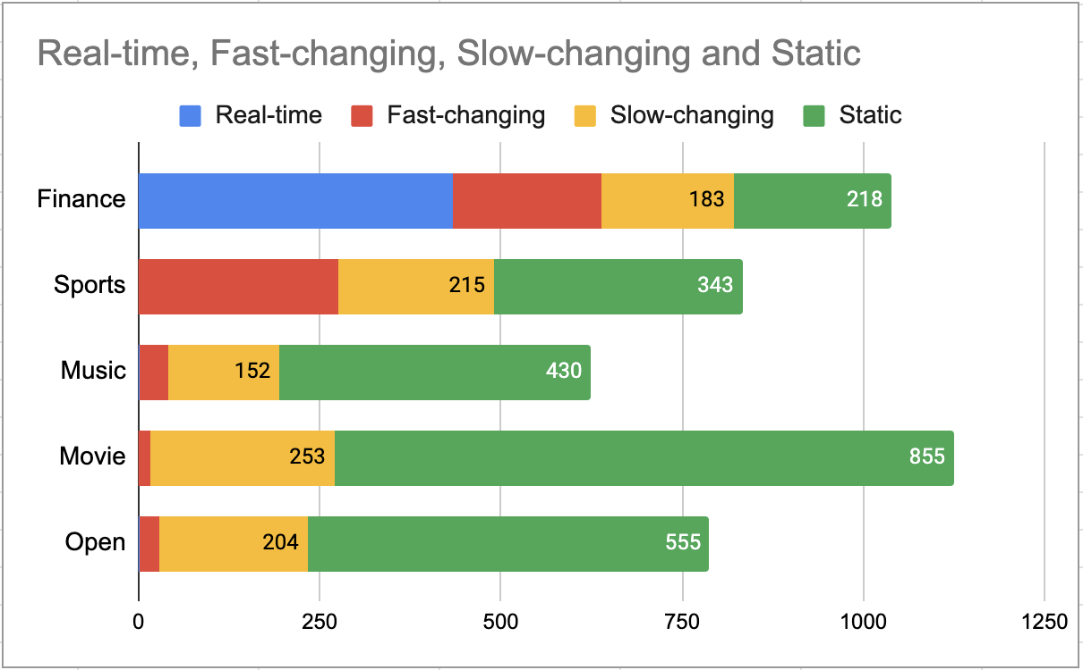
Rich and Insightful Question-answering Set
4400+ QA pairs from 5 domains (Finance, Sports, Music, Movie, Encyclopedia)
Questions for static, slow-changing, fast-changing, and real-time information
Questions for head, torso, and tail entities
Simple-fact questions and complex questions
434
204
275
Total | Simple | Simple w. Cond | Set | Comparison | Aggregation | Multi-hop | Post- processing | False Premise
4409 | 1205 | 689 | 403 | 546 | 489 | 382 | 180 | 525

Slide 11
Accessible Retrieval Content
Web search:
220K webpages: 50 webpages for each question from BraveAPI web search
KG & API search:
Mock KG: 2.6M entities, 30:1 signal-to-noise ratio
Mock APIs: 38 mock APIs
434
204
275

Slide 12
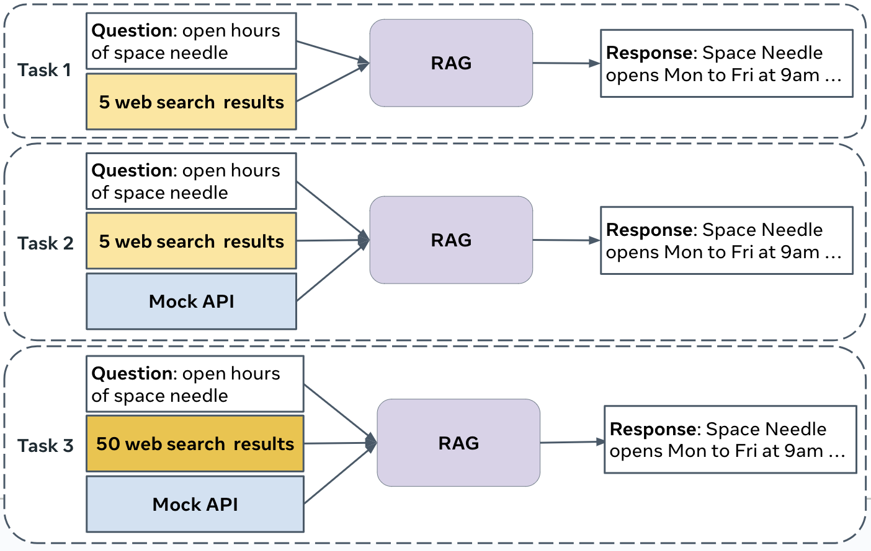
Carefully-designed CRAG Tasks
Retrieval Summarization.
KG and Web Retrieval Augmentation.
End-to-end RAG.
Three tasks build up information gradually to test different capabilities of RAG systems.

Slide 13
Reliable Evaluation
Metrics:
Perfect, Acceptable, Hallucination, Missing
Truthfulness = Perfect rate + 0.5 * Acceptable rate - Hallucination rate
Evaluation
Auto-eval selected top-15 teams from each Task.
Manual-eval determined the final winners.
434
204
275

Slide 14
KDD Cups Winning Solutions
Tasks | Auto-eval |  |  | Manual-eval
 | GPT-4 | Llama 3 | KDD Cup Winning team
Task 1 | 8% | 5% | 28% | 30%
Task 2 | 16% | 8% | 30% | 32%
Task 3 | 13% | 9% | 31% | 36%
434
204
275
A big jump

Slide 15
KDD Cup:
CRAG - Comprehensive RAG Benchmark
Task 1:
💐 Simple_w_condition Question: Team dummy_model
💐 Set Question: Team dummy_model
💐 Comparison Question: Team dRAGonRAnGers
💐 Aggregation Question: Team dummy_model
💐 Multi-hop Question: Team bumblebee7
💐 Post-processing Question: Team dRAGonRAnGers
💐 False Premise Question: Team ETSLab
Task 2:
💐 Simple_w_condition Question: Team ElectricSheep
💐 Set Question: Team ElectricSheep
💐 Comparison Question: Team dRAGonRAnGers
💐 Aggregation Question: Team ElectricSheep
💐 Multi-hop Question: Team ElectricSheep
💐 Post-processing Question: Team ElectricSheep
💐 False Premise Question: Team Future
Task 3:
💐 Simple_w_condition Question: Team StarTeam
💐 Set Question: Team md_dh
💐 Comparison Question: Team dRAGonRAnGers
💐 Aggregation Question: Team md_dh
💐 Multi-hop Question: Team ETSLab
💐 Post-processing Question: Team md_dh
💐 False Premise Question: Team Riviera4
Task 1:
Team db3
Team md_dh
Team ElectricSheep
Task 2:
Team db3
Team APEX
Team md_dh
Task 3:
Team db3
Team APEX
Team vslyu-team

Slide 16
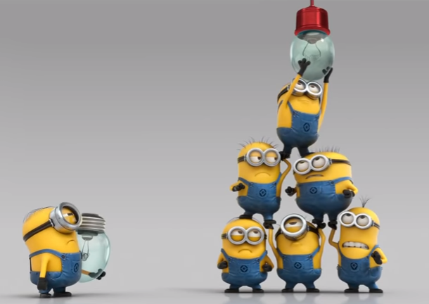
What did we learn?
Keep a private test set. 📜
Be prepared to be surprised. 😱
Answer forum questions in time; it helps clarify grey areas and resolve issues. 🐞
Do some accounting! Otherwise computation cost can be prohibitive! 💰
Manual eval takes really long. ⌚️

Slide 17
Acknowledgement
All KDD Cup Challenge participants
AICrowd
Many many partners
Jinsong Yu, Alex Boesenberg, Sam Wexler, Hejia Zhang, Rares Bostan, Eryk Helenowski, Nanshu Wang, Sinong Wang, Denis Savenkov, Katie Manlove, David Vu, Florian Gawlitta, Rani Salomi Pitta, Lauren Gregory Mikus, Tara Welch, Nidhi Modi, Ray De Leon, Jader Ricarte, Joshua Aranzaso, Apoorva Srinivas, Courtnee Parker, Jackie Leader, Mindy Abern, Heather Nolan, Ty Toledano, George Lan, Ben Edgar, Sy Choudhury, Rodrick Shepard, Katie Manlove, Mavis Hu, Jen Vinz, Taha Masood, Parkin Kent, Rebekkah Hogan, Tony Nelli, Jennifer Pak, Jonathan Torres and Amy Lee.

Slide 18
Effective RAG Techniques
Promises and Limitations of Retrieval-augmented Language Models
Akari Asai et al., “Reliable, adaptable, attributable LMs with Retrieval.” Arxiv 2024 (slides originally made by Akari Asai)
Some observations on the winning systems

Slide 19
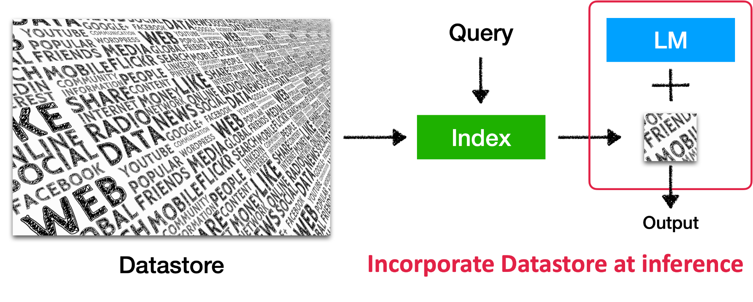
Retrieval-augmented LMs
Slides adapted from the ACL-23 tutorial: Retrieval-based Language Models and Applications

Slide 20
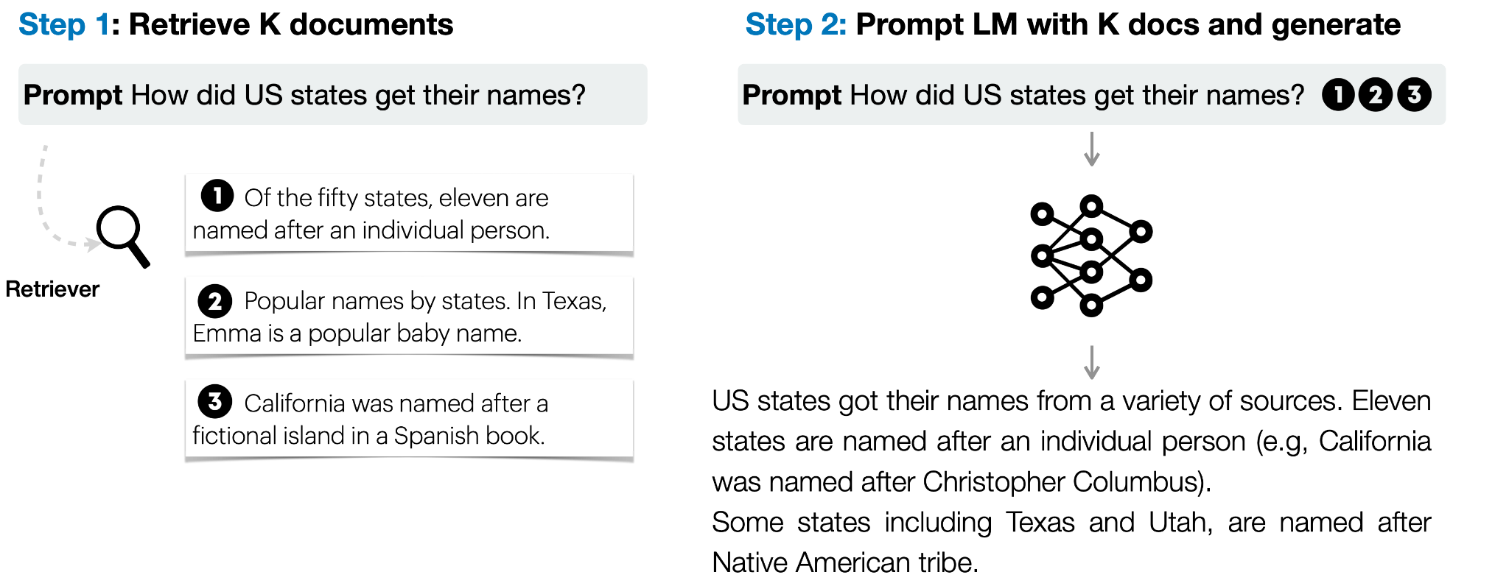
Vanilla Retrieval-augmented Generation (RAG)
Lewis et al. Retrieval-augmented generation for knowledge-intensive NLP tasks. NeurIPS 2020 Shi et al. REPLUG: Retrieval-Augmented Black-Box Language Models. NAACL 2024

Slide 21
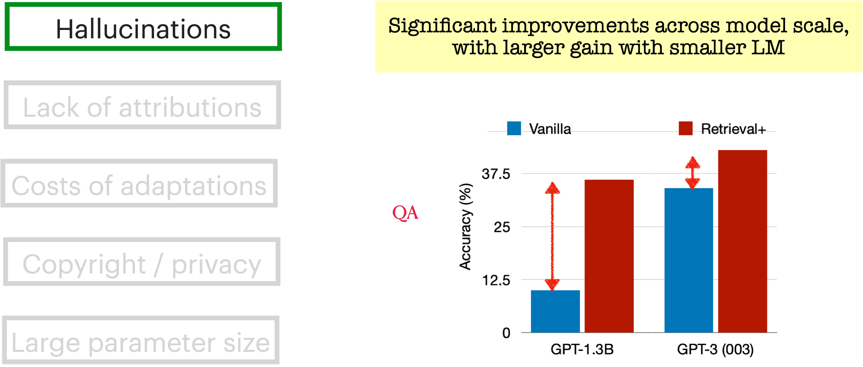
RAG Mitigates Weaknesses of Large Language Models
Mallen*, Asai* et al., When Not to Trust Language Models: Investigating Effectiveness of Parametric and Non-Parametric Memories (Best Video; Oral) 2023.

Slide 22
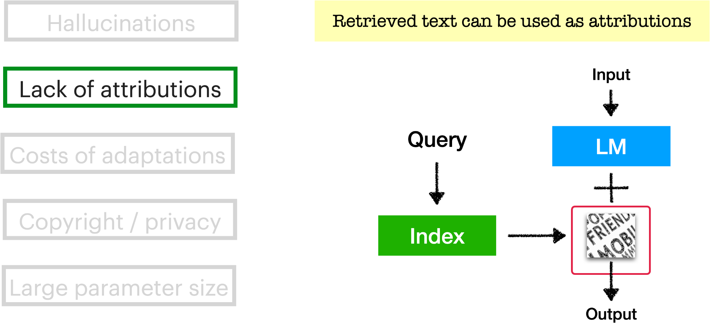
RAG Mitigates Weaknesses of Large Language Models

Slide 23
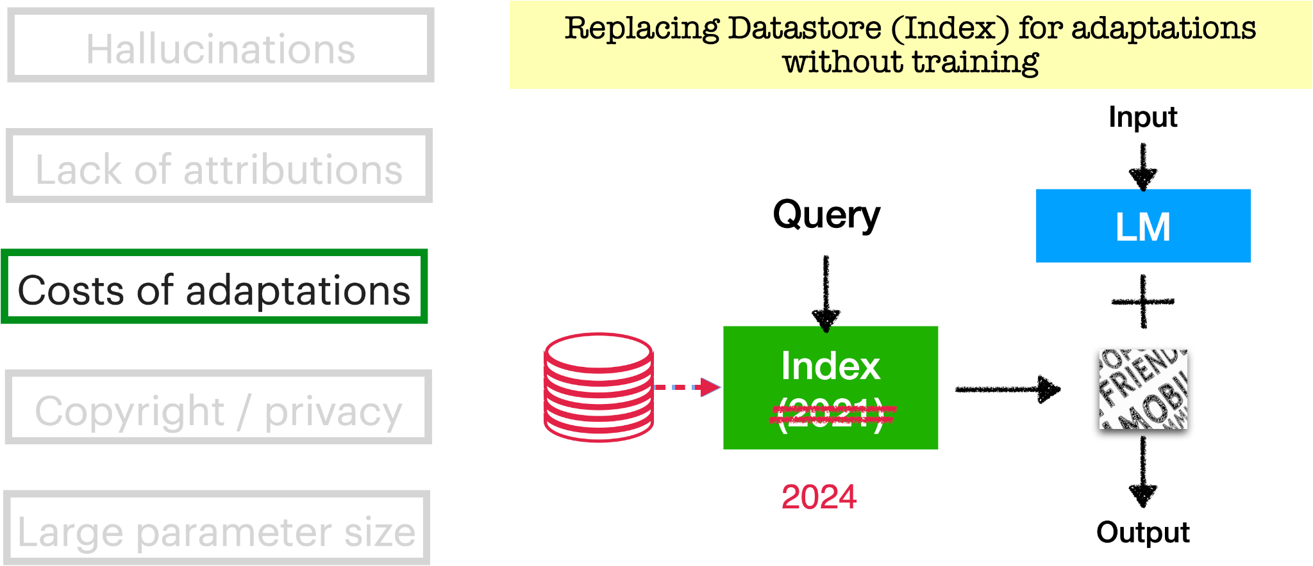
RAG Mitigates Weaknesses of Large Language Models
Izacard*, Lewis* et al., Atlas: Few-shot Learning with Retrieval Augmented Language Models. JMLR 2023.

Slide 24
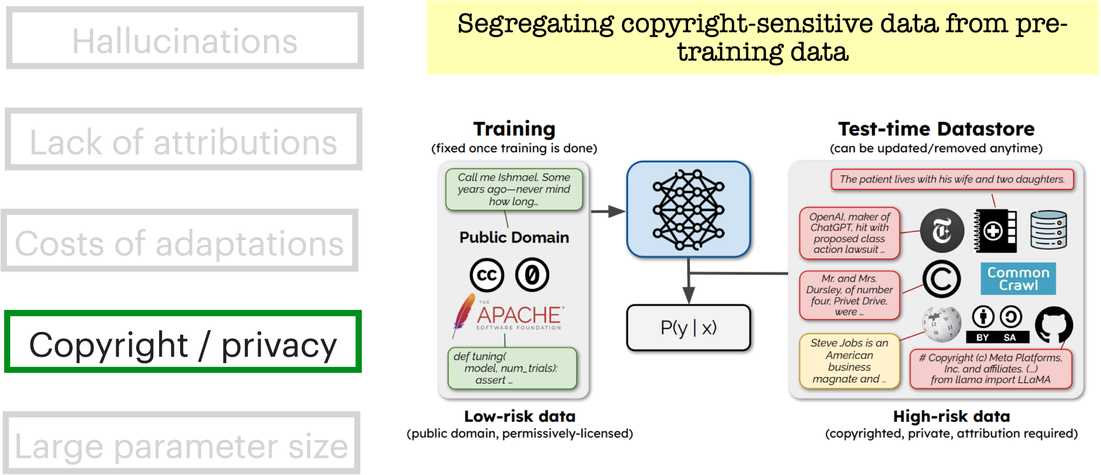
RAG Mitigates Weaknesses of Large Language Models
Min* and Gururangan* et al., SILO Language Models: Isolating Legal Risk In a Nonparametric Datastore. ICLR 2024.

Slide 25
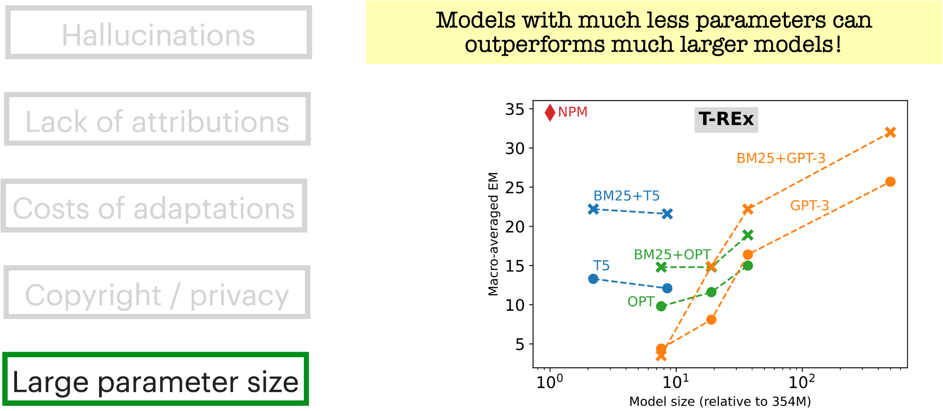
RAG Mitigates Weaknesses of Large Language Models
Min et al., Nonparametric Masked Language Modeling. Findings of ACL 2023.

Slide 26
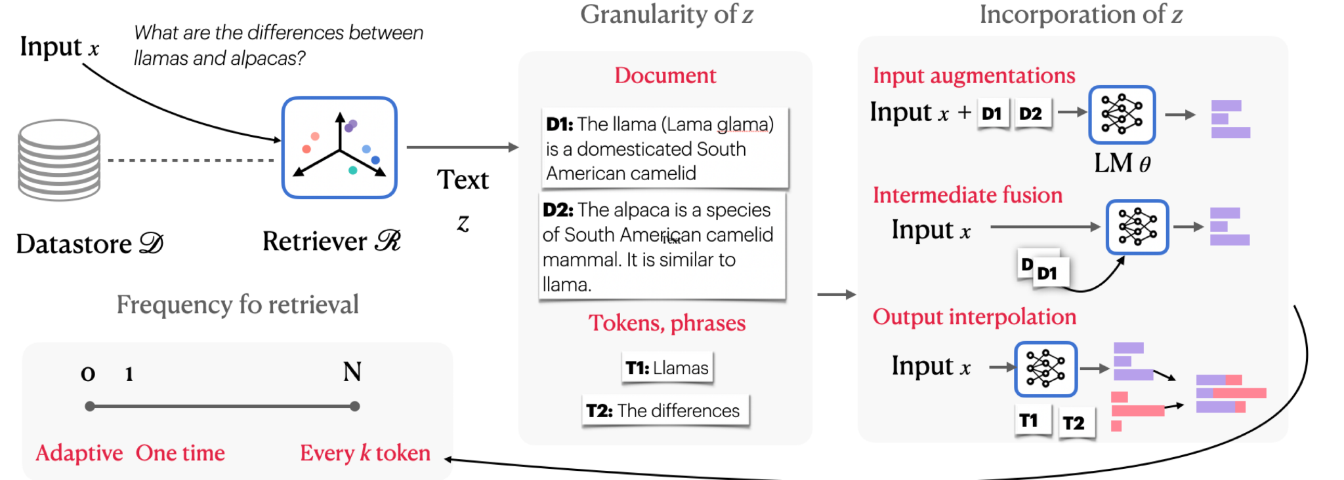
Diverse Architectures of Retrieval-augmented LMs

Slide 27
Vanilla RAG: Just One Type of Retrieval-augmented LMs

Slide 28
Observations on CRAG Winning Systems
No sophisticated model modification
LLM is mostly untouched (but tuned for reducing “hallucination”)
Retrieved information is incorporated through input augmentation
Retrieval quality (granularity of the retrieved information)
LLM generation (incorporation of the retrieved information)
Specific system design tailored to the tasks

Slide 29
Retrieval Quality -- db3
Web retrieval: Better chunks by leveraging DOM, reranking
KG retrieval: A new type of “regularized” API
Easy to parse and execute
Leverages the characteristic of relational databases
Xia et al., Winning solution for Meta KDD Cup’24. Figure 1

Slide 30
LLM Generation -- APEX
Chain of Thoughts (CoT) prompting
Better handle complex tasks
Significantly reduce hallucinations
In-context Learning
Improve model’s ability to recognize invalid questions

Slide 31
Specific System Design
Reduce the “hallucination” penalty
Supervised fine-tuning (db3)
Heuristic rules + prompt engineering (ElectricSheep)
Thresholding on confidence values (dRAGonRAnGers)
Identify the question “type” (e.g., domain, static/dynamic)
“Attribute predictor” (ElectricSheep)
“Domain router and Dynamic router” (APEX)

Slide 32
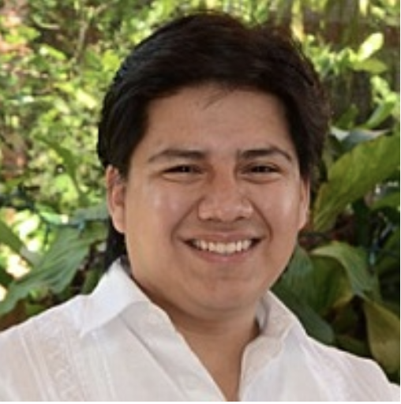
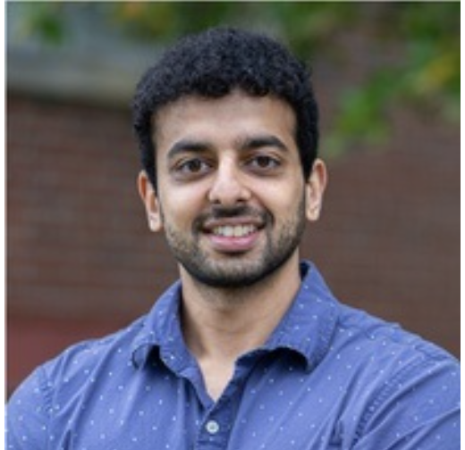
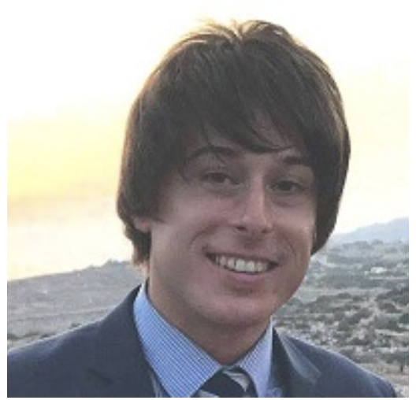
Workshop Today
Keynote speakers: Juan Sequeda, Mohit Iyyer, Patrick Lewis https://kddcup24.github.io/pages/keynotes.html
Winning team talks
Poster session

Slide 33
Schedule - https://kddcup24.github.io/pages/schedule.html
11:00 - 11:30 | Opening remarks and competition summary | Xiao Yang / Scott Yih
11:30 - 12:05 | Keynote: Increasing the LLM Accuracy for Question Answering on Structured Data: Knowledge Graphs to the Rescue! | Juan Sequeda
12:05 - 13:05 | Team talks #1 | APEX, db3, md_dh
13:05 - 14:00 | Lunch break
14:00 - 14:35 | Keynote: How can retrieval aid long-form text generation? | Mohit Iyyer
14:35 - 15:10 | Keynote: RAG, Past, Present, Future | Patrick Lewis
15:10 - 15:55 | Team talks #2 | dRAGonRAnGers, dummy_model, ElectricSheep
15:55 - 16:00 | Closing remarks | Luna Dong
16:00 - 16:30 | Poster Session

Slide 34
THANK YOU

